Slide 1



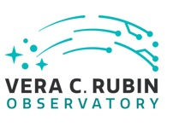
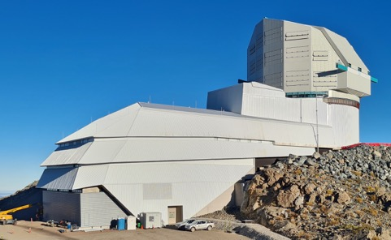

Red noise time series
– intro tutorial with jupyter notebook examples
Andjelka Kovacevic
@matf.bg.ac.rs
ADA Master program
Notes:
The perfect case for the time-domain investigations are quasars (i.e., active galactic nuclei) since they are luminous objects that show strong variability. Key results of quasar variability investigations are estimated properties of a supermassive black hole (SMBH), which resides in the center of a quasar, and how they connect with the host galaxy. These give an essential link to the studies of galaxy evolution and cosmology.
With the advances of technology and robotization of telescopes, we have entered the era of massive time-domain observations, with several missions already running and producing amazing results. The Sloan Digital Sky Survey (SDSS) is, for sure, the most famous and successful example. In the next decade, we expect to have comprehensive monitoring campaigns, out of which the Vera Rubin Observatory Legacy Survey of Space and Time (LSST) with its very high cadence 10-year photometric survey seems to be very promising for the quasar investigations. LSST will provide millions of quasar photometric light curves, which will facilitate better understanding of the physical processes that power quasars and their variability (Brandt et al. 2018). One particular class of objects are so-called changing-look quasars, which show extreme variability and may reveal the answers to these questions (Ili ́c et al. 2020). So far, surveys have discovered only a small fraction of changing-look candidates, but LSST will be able to discover many or even show that this phase is not so rare. LSST will be complemented with several spectral surveys, such as the Maunakea Spectroscopic Explorer (MSE, MSE Science Team 2019). This survey will cover both the time and spectral domain, including also the infrared band, which is important for the high-redshift quasar studies. The MSE will, with its multi-object spectrographs, provide spectral light curves of a large number of quasars.
In this talk, we review the current status of quasars variability investigations in Serbia, in the perspectives of the present and future monitoring campaigns (Kovacevic et al. 2020a,b). Special focus will be on our participation in the future two big projects LSST and MSE.

Slide 2
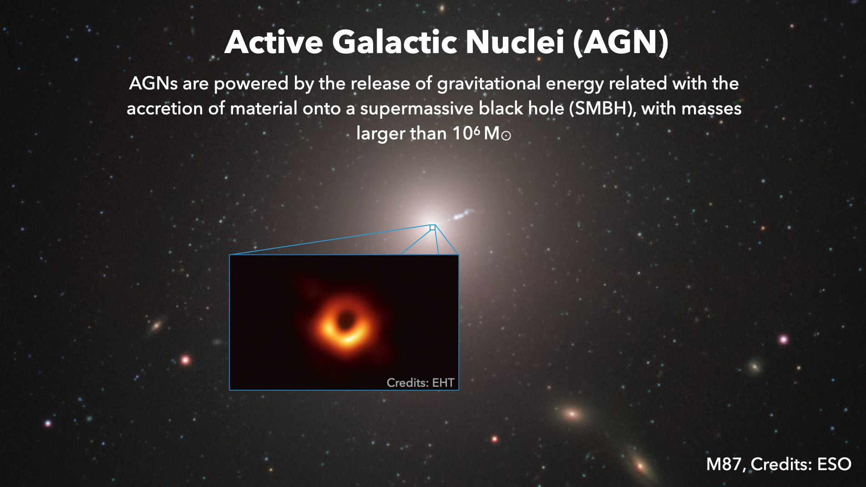
M87, EHT Collaboration, 2019

Slide 3
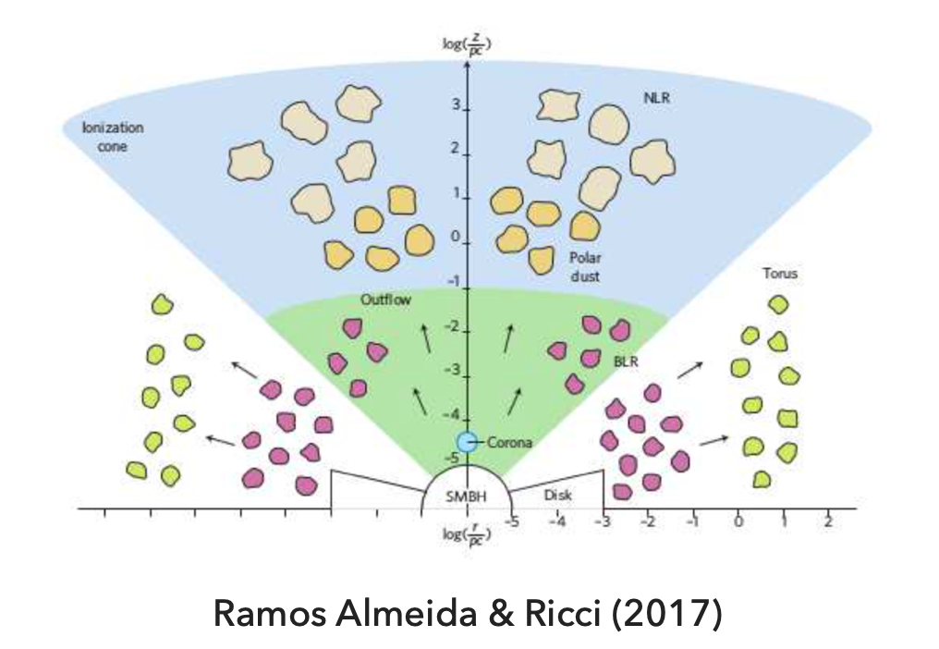
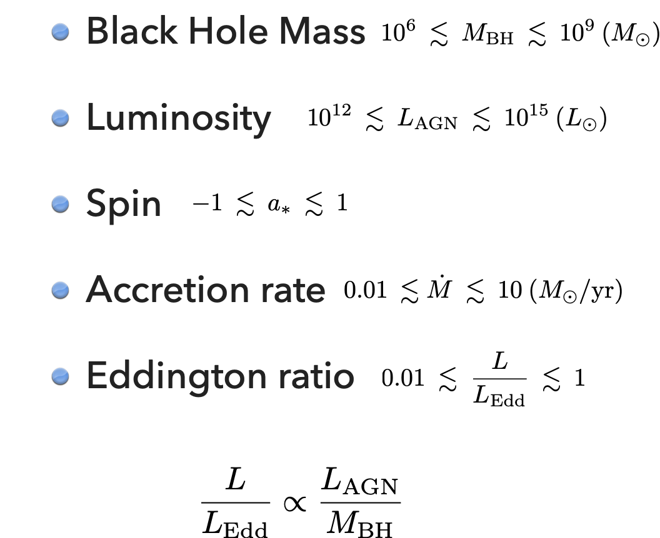
Active Galactic Nuclei (AGN) - ID card
How can we reveal the inner structure?

Slide 4
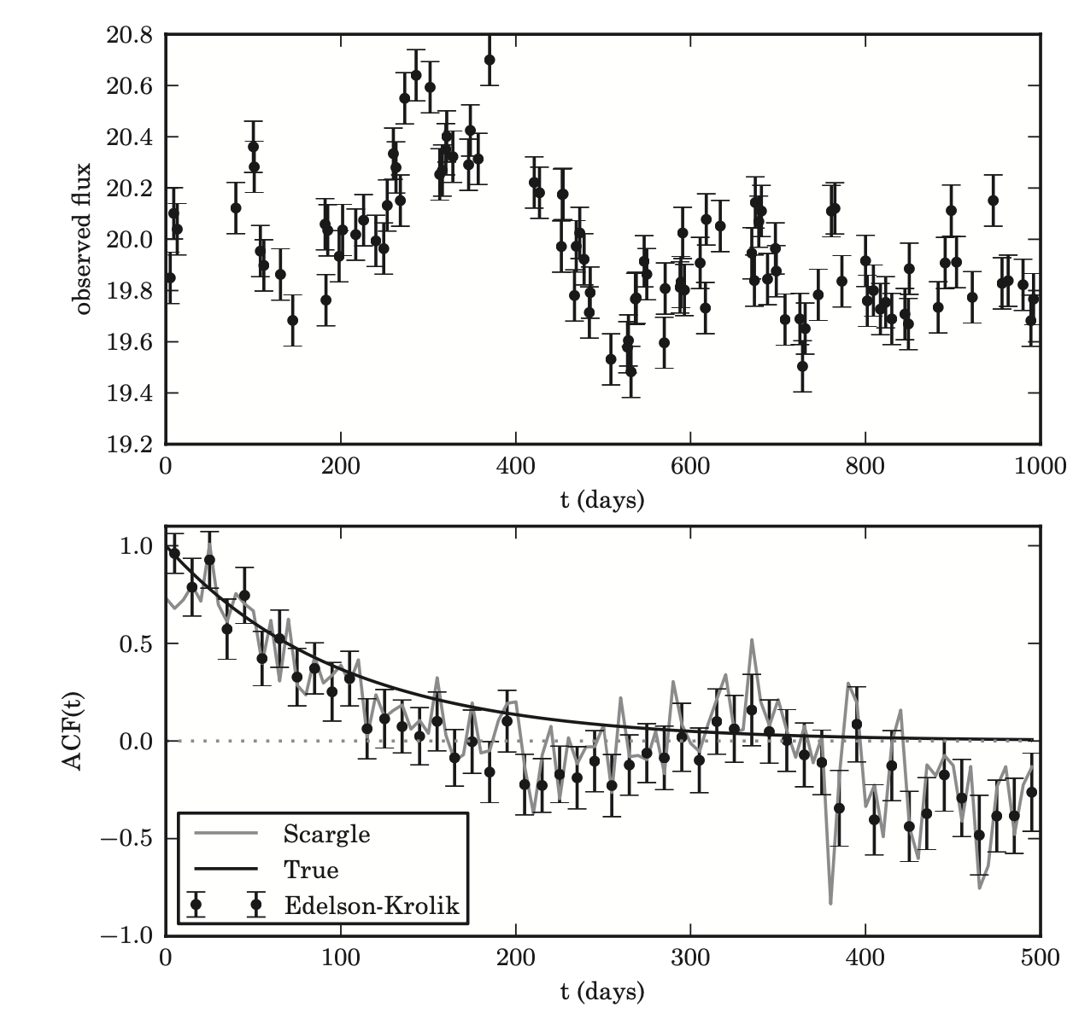
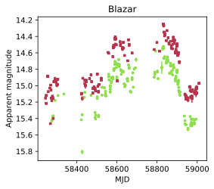
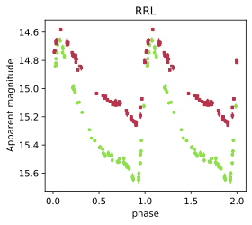
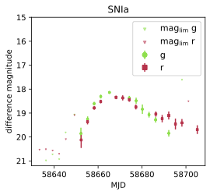
AGN Variability: what do we know?
AGN variability seems to be well described as a stochastic process: behavior that is not predictable forever as in the periodic case, but unlike temporally localized events (transient), variability is always there
Stochastic
Periodic
Transient
credits: Sánchez-Sáez et al. 2021a.
for more details see Kozlowski et al. 2016
Notes:
grafici pokazuju da je vraijabilnost sothasticna i da podseca na rednoise

Slide 5
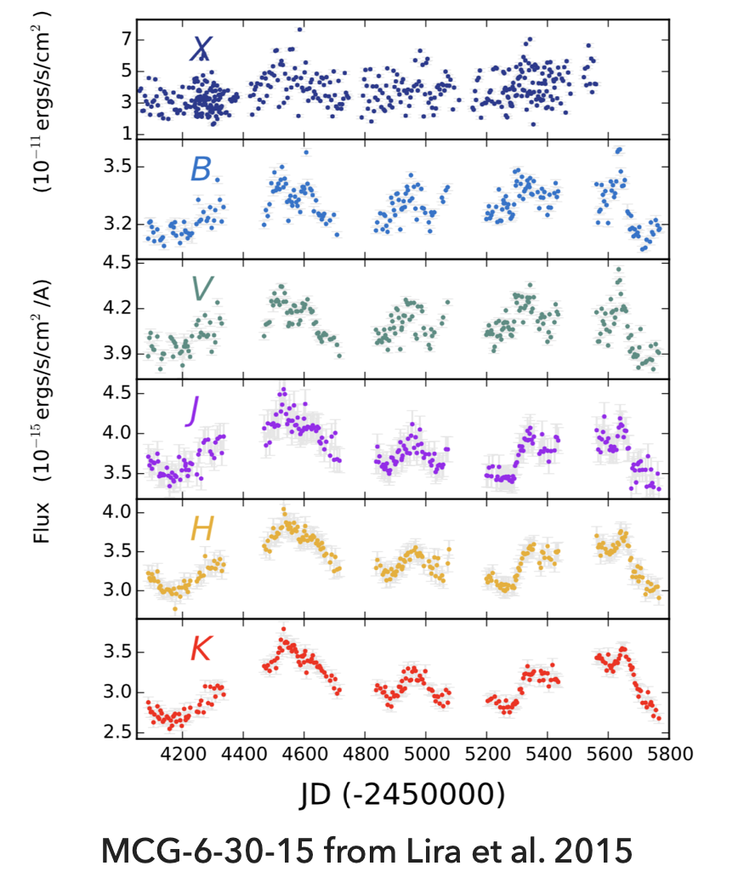
AGN Variability: what do we know?
The characteristic time-scales of the variability range from hours to years, with the shortest time-scales being associated with shorter emission wavelengths.
There is a connection between the variations seen at different wavelengths.

Slide 6
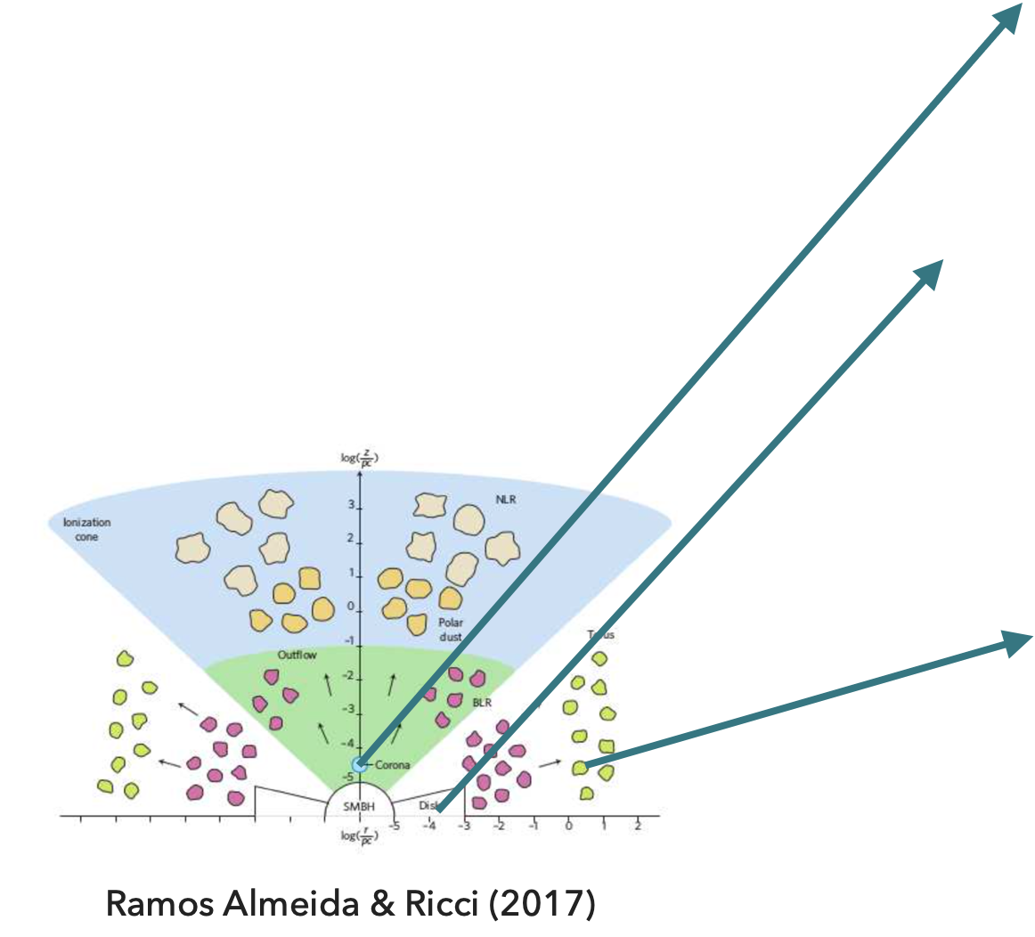
AGN Variability: what do we know?
The characteristic time-scales of the variability range from hours to years, with the shortest time-scales being associated with shorter emission wavelengths.
There is a connection between the variations seen at different wavelengths.

Slide 7
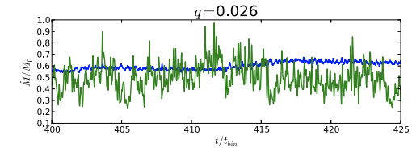
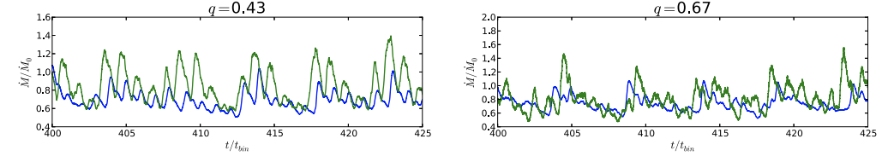
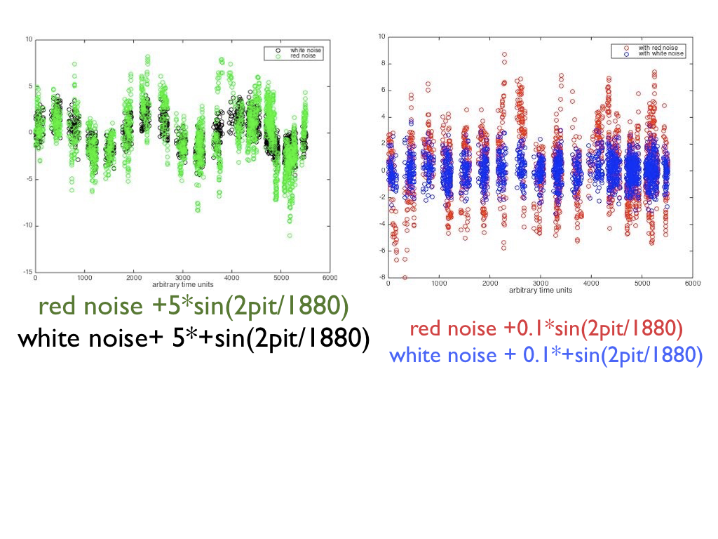
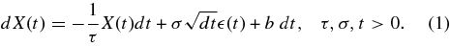
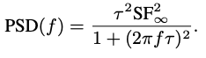
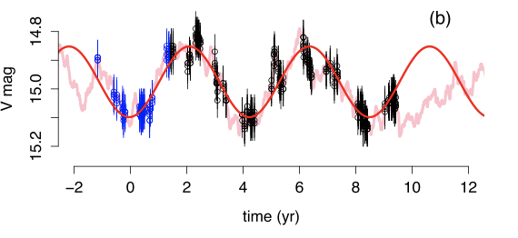


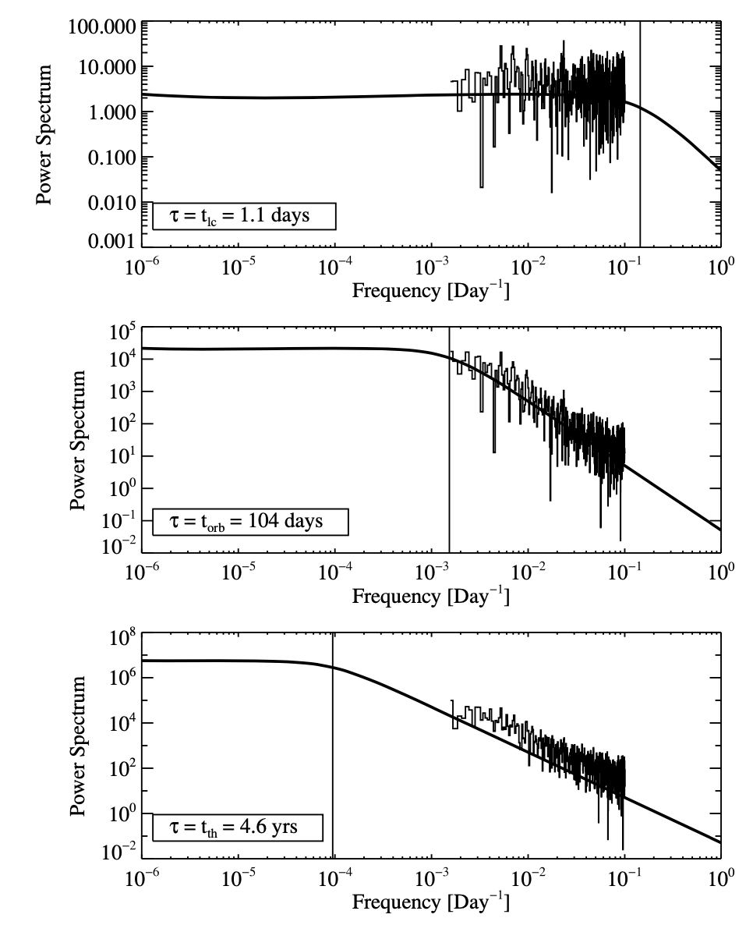
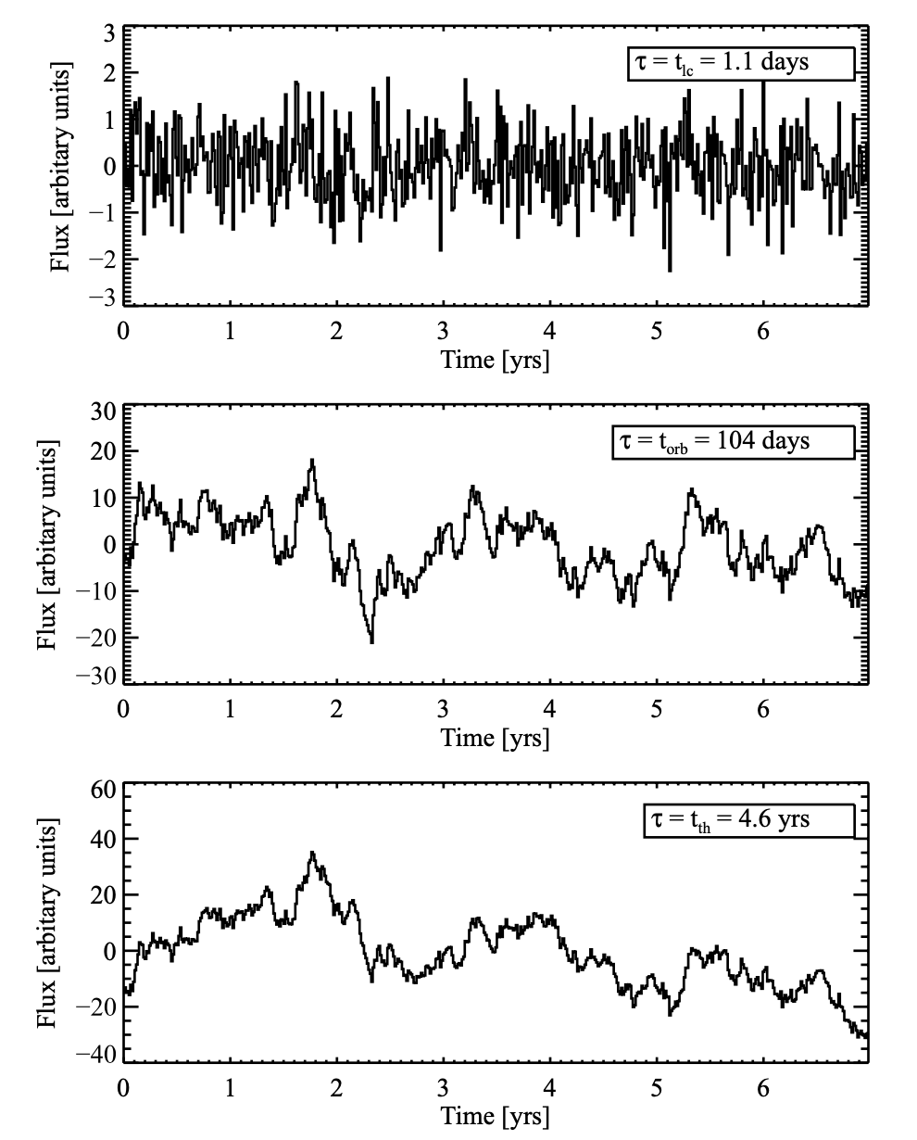
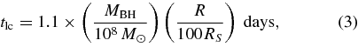
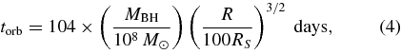
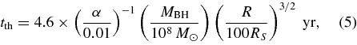
VARIETY OF SIGNALS IN AGN EMISSION LIGHT CURVES
Burst model (fig. 9 of Farris et al. 2014)
Periodicity signal immersed in red noise
The power spectral density (PSD) for the DRW is (Kelly et al 2009)
Red Noise mimics periodicity (fig. 1 of Vaughan et al 2016)
accretion disk thermal timescale.
light crossing
time scale
Fourier transform
the gas orbital timescale
accretion disk
thermal timescale.
Kelly et al 2009
Notes:
The other competing model for oscillatory signal is a more bursty, quasi-periodic variability model predicted by hydrodynamic simulations of circumbinary accretion discs by Faris et al 2009. In the simulations, significant periodicity in the accretion rates emerges only for q ≳0.1, where the binary torques are large enough to excite eccentricity in the inner cavity and create an overdense lump. The passing BHs interact with the overdense lump, producing periodicity in the accretion rate.
https://academic.oup.com/mnras/article/500/3/4025/5920624
https://iopscience.iop.org/article/10.1088/0004-637X/783/2/134/pdf
Thus the power spectrum decreases for variations shorter than τ_{DRW} (i.e. ‘red’ at higher variation-frequencies), but approaches a constant value for longer time-scales (i.e. ‘white’ at lower frequencies). In this context, the most important feature of red-noise spectra is their natural tendency to produce coherent excursions from the mean at longer time-scales. These excursions can easily resemble order unity cycles of sinusoidal variations (like Doppler boosting) or one-off peaks (like lensing flares). In red-noise regimes of parameter space, multiple complete cycles, repeated flares, or external constraints are often needed to confirm signals.Kelly et al directly model the quasar optical light curves as a stochastic process, in contrast to previous work based on more traditional Fourier (i.e., spectral) techniques. Our method allows us to describe quasar light curves with three free parameters: a characteristic timescale, amplitude of short-timescale variability, and the mean value of the light curve.
It is tempting to associate τ with a characteristic timescale, such as the time required for diffusion to smooth out local accretion rate perturbations, and σ to represent the variability resulting from local random deviations in the accretion disk structure, such as caused by turbulence and other random MHD effects.
The increased amount of variation on long timescales with increasing τ is apparent. In addition, because tlc is shorter than the time sampling, the first simulated light curve is only sampling frequencies on the flat part of the power spectrum, giving it the appearance of white noise. In contrast, the two simulated light curves with the longest timescales are sampled on the 1/f2 part of the power spectrum, giving them more of a "red noise" appearance.

Slide 8
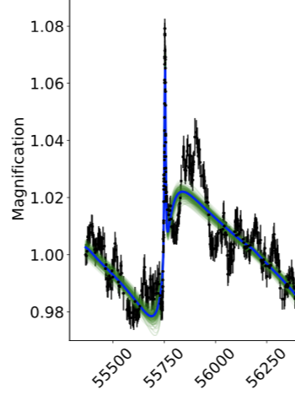
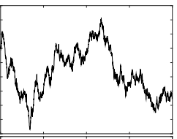
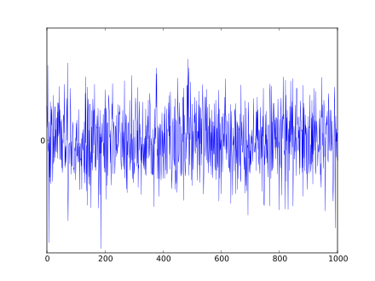
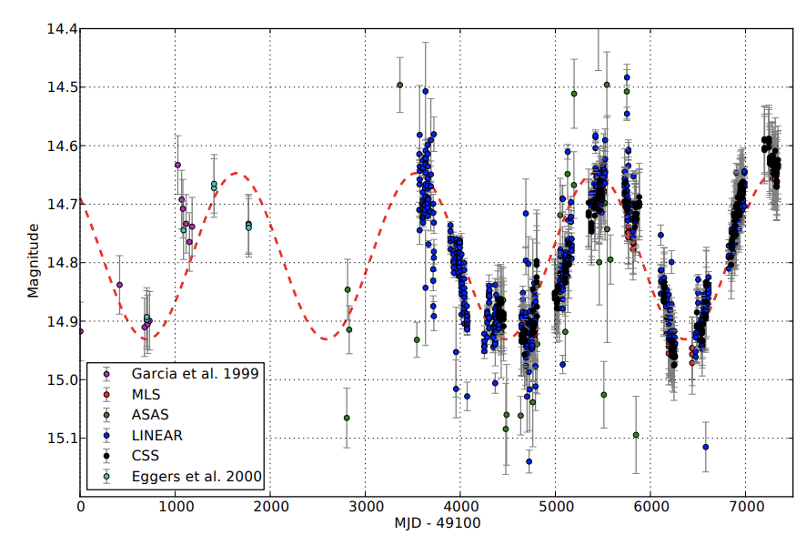
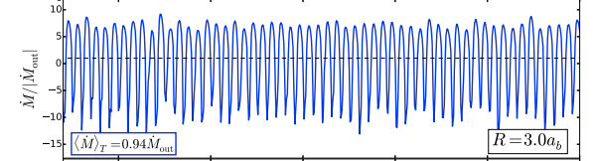
VARIETY OF SIGNALS IN AGN EMISSION LIGHT CURVES
Observed Flux =Steady mean X ( Doppler boost) X (Gravitational) X (Red noise) + Photometric noise
flux microlensing
FLUX
Optical light curve for Spikey,
Hu et al 2020
TIME
Observed Flux= Steady mean X (time variable accretion) X (Red noise) + Photometric noise
flux
Graham et al 2015
Munoz& Lai 2016
FLUX
TIME
Notes:
periodic variability may be imprinted by the orbital
motion of a sub-pc separation SMBHB via time variable accretion (e.g., Artymowicz & Lubow 1994; Hayasaki et al. 2007; MacFadyen & Milosavljevic´ 2008; Cuadra et al. 2009; Shi et al. 2012;
D’Orazio et al. 2013; Farris et al. 2014; D’Orazio et al. 2015a; Shi
& Krolik 2015; Muñoz & Lai 2016; Bowen et al. 2019), or by the
relativistic Doppler boost (D’Orazio et al. 2015b). It has also been
suggested that binary self-lensing, which would occur if the accretion flow from one black hole was gravitationally lensed by its
partner, could serve as a signature of SMBHBs (D’Orazio & Di
Stefano 2018, hereafter D18)
In addition to a steady mean flux F0, we consider four components in our light curve model: the Doppler boost, gravitational microlensing, stochastic noise described by the damped random walk
(DRW) model, and photometric noise,
Relativistic Doppler boosting will likely dominate the photometric variability for unequal mass-binaries and for orbits that are relatively close to edgeon (𝑖 = 90◦), (D’Orazio et al. 2016); In addition to Doppler boost variability, in
unequal mass binaries with orbits close to edge-on, periodic selflensing flares may also be observed (D’Orazio & Di Stefano 2018;
Hu et al. 2020).
As for periodic accretion
The binary perturbs the circumbinary disk leading to periodic leakage of gas into the cavity (MacFadyen & Milosavljević 2008; D’Orazio et al. 2013), which may be translated to periodic brightness fluctuations of the binary. Periodic variations may be observed at the orbital period of the binary or at a few times the orbital period of the binary, depending on the binary’s mass ratio (D’Orazio et al. 2013; Farris et al. 2014; Noble et al. 2021), and the eccentricity (Miranda et al. 2017) discussed below. The periodicity coincides with the orbital period for unequal-mass binaries, whereas for relatively equal-mass binaries, the dominant periodic component is expected at a several (∼ 5 − 8) times the orbital period (D’Orazio et al. 2013; Farris et al. 2014; Miranda et al. 2017). This timescale corresponds to the orbital period of a hotspot (over-density) formed at the edge of the circumbinary disk (Shi et al. 2012; Farris et al. 2014). The exact mass-ratio where the transition occurs is still uncertain and depends on the simulation setup (D’Orazio et al. 2013; Farris et al. 2014; Muñoz et al. 2020).
Beyond periodic accretion, relativistic Doppler boosting can also produce periodic photometric variability (D’Orazio et al. 2015b; Tang et al. 2018). For compact, milli-parsec binaries, the SMBHs (and thus the mini-disks around them) move at a fraction of the speed of light, and effects of special relativity are inevitable. For instance, the secondary mini-disk – which is typically more luminous and the one moving faster – will appear brighter when it is moving towards the observer and dimmer when it is moving away. Relativistic Doppler boosting will likely dominate the photometric variability for unequal mass-binaries and for orbits that are relatively close to edgeon (𝑖 = 90◦ ). Doppler boosting can produce significant periodicity, even if the rest-frame luminosity of the mini-disks is constant, which

Slide 9
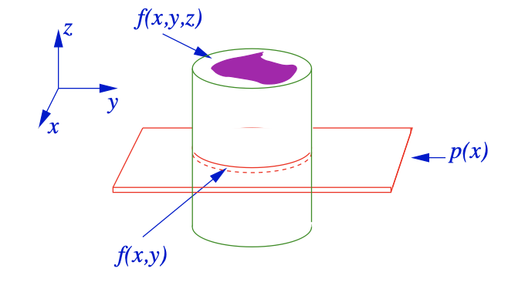
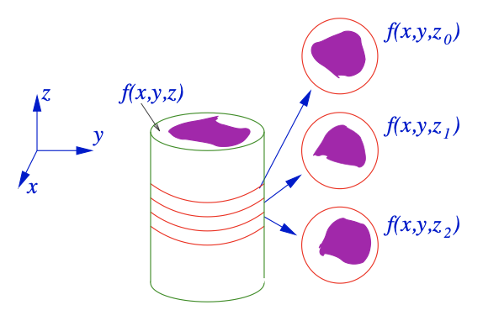
TOMOGRAPHIC IMAGING
Basic layout of a tomographic system to image a slice through a three-dimensional object.
Imaging of a three-dimensional object by taking a series of slices.
Images Credit: School of Physics DIA(U01358) and TOIP(P00809)
Notes:
Andjelka

Slide 10
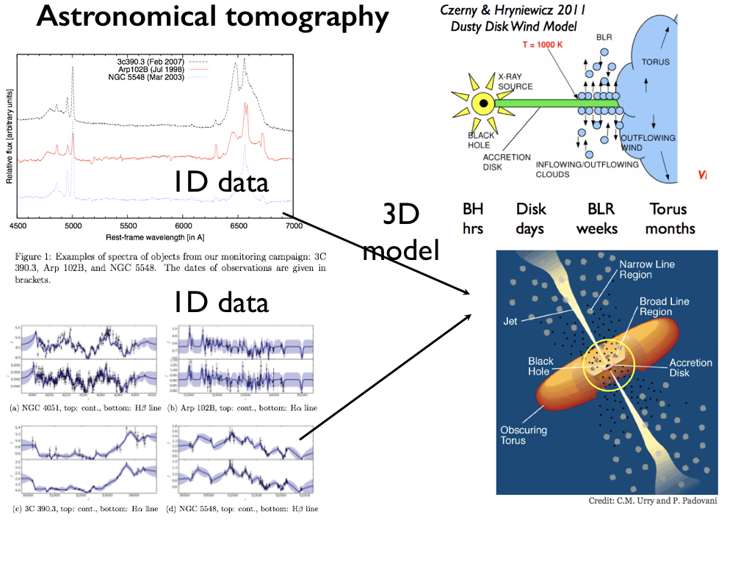
time-delay between continuum and line flux
time-delay = size of the broad line region (BLR)
Notes:
Andjelka

Slide 11
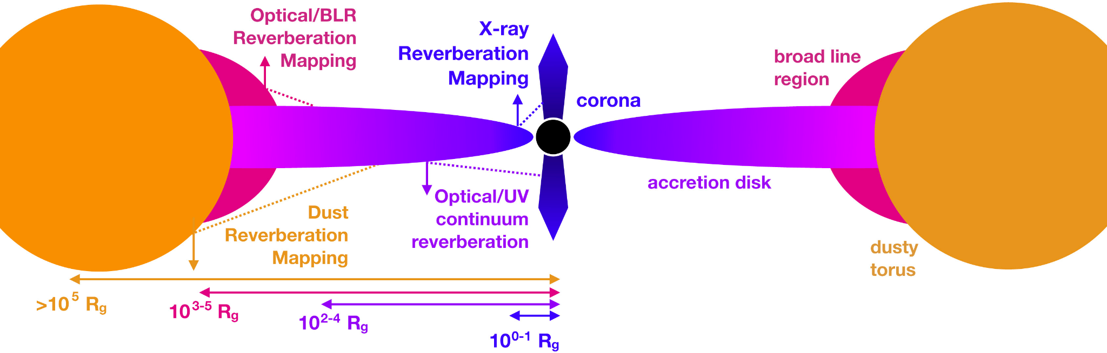
4 types of reverberation mapping
Historical papers: Lyutyi & Cherepashchuk, 1972; Blandford & McKee, 1982; Gaskell & Sparke, 1986;
Cackett+21: The schematic highlights the main components and the four types of reverberation: X-ray reverberation, optical/UV continuum reverberation broad line region reverberation, and dust reverberation ( with general radial scales from the black hole indicated by labels.
Notes:
Andjelka

Slide 12
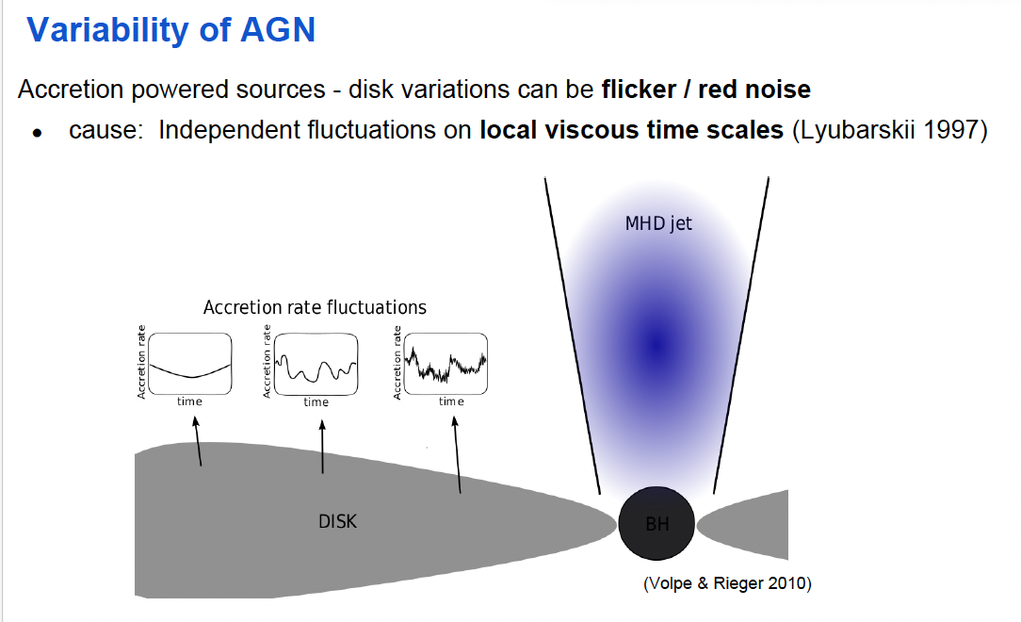
Kastendieck, Horns +13

Slide 13

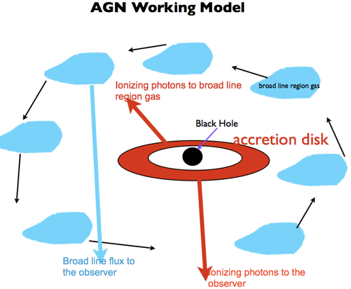


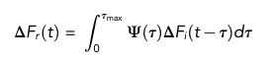
Optical/UV AGN reverberation mapping
DFiðtÞ
Simplified assumptions of reverberation mapping:
(a) the irradiating flux (red color in Figure left) originates from a single central source,
(b) that the light travel time is the most important timescale
(c) the relationship between the observed reprocessed (blue color in Figure left) and ionizing fluxes (red color in Figure left) is linear.
DFiðtÞ
irridating flux
output reprocessed flux
TRANSFER FUNCTION
Notes:
Andjelka

Slide 14
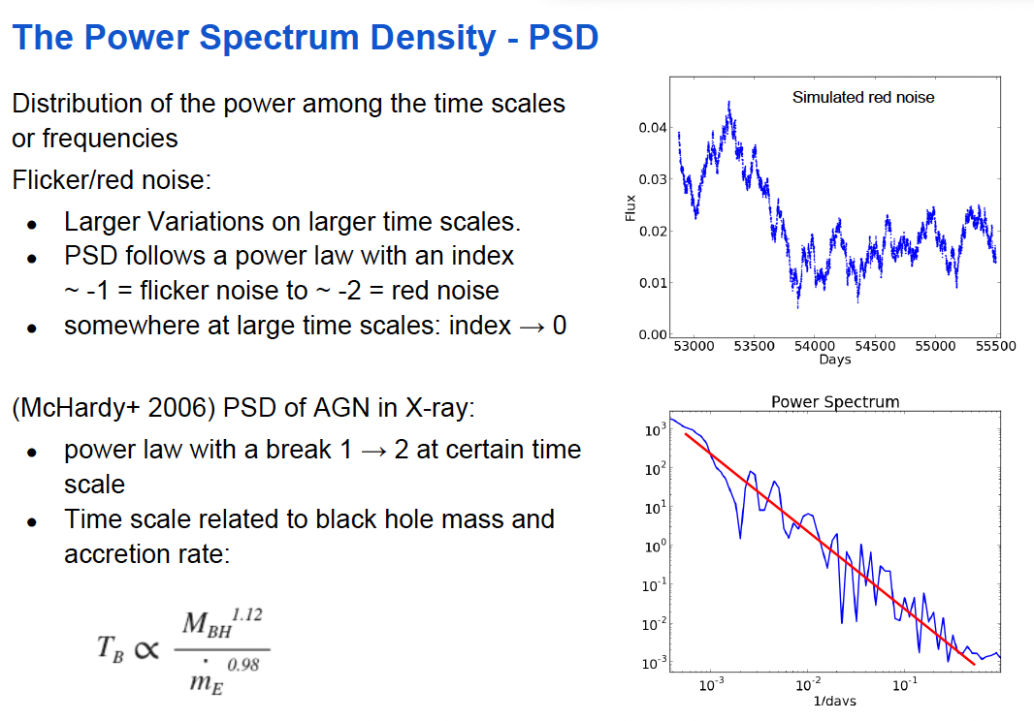
Kastendieck, Horns +13

Slide 15
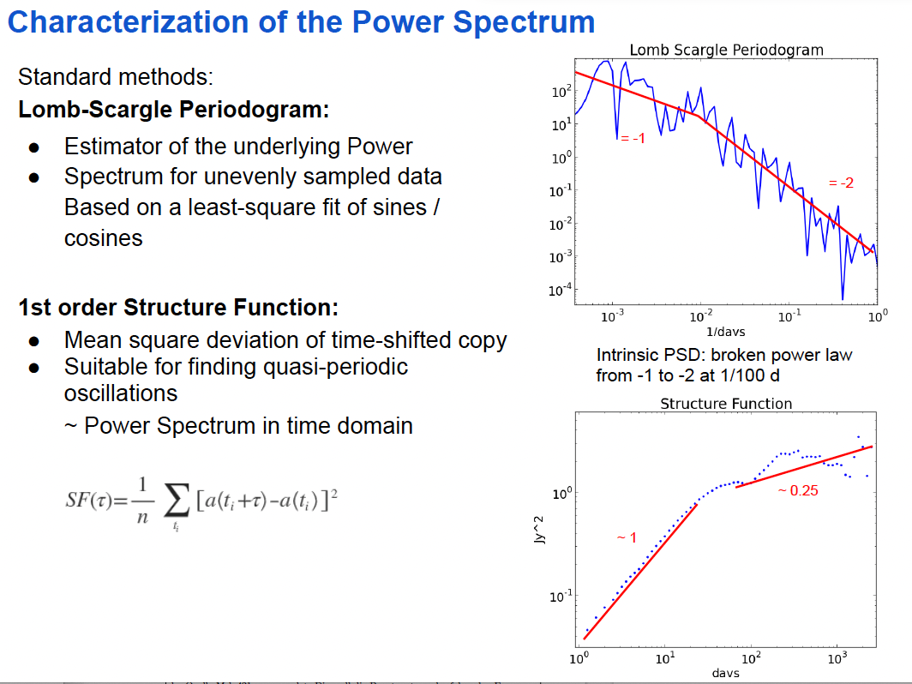
Kastendieck, Horns +13

Slide 16
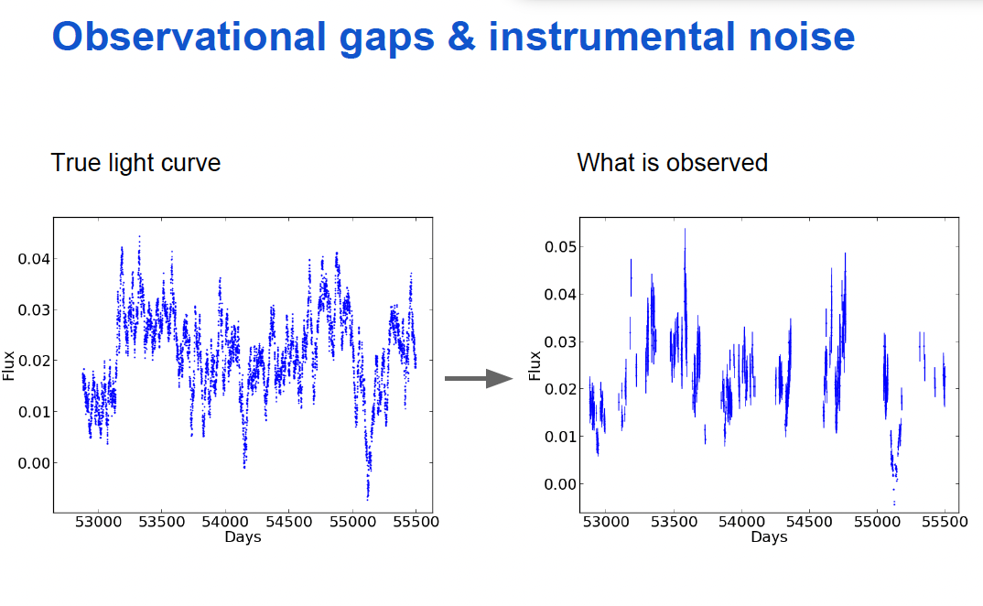
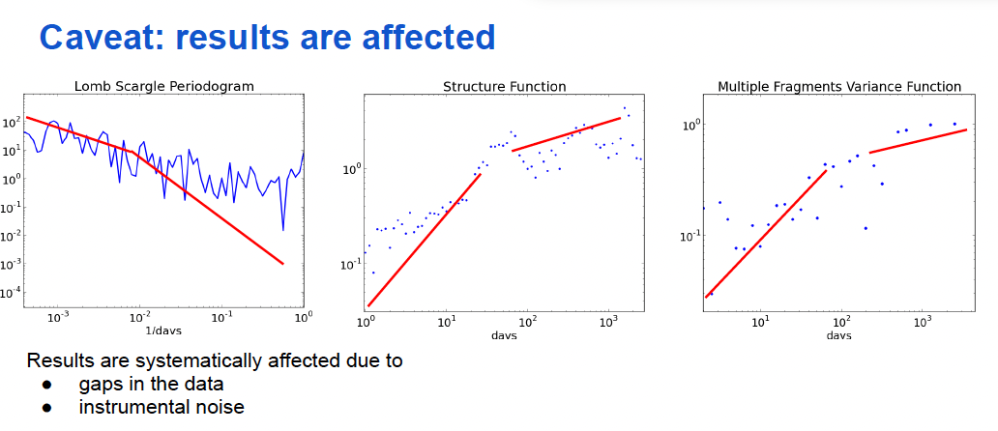
Kastendieck, Horns +13

Slide 17
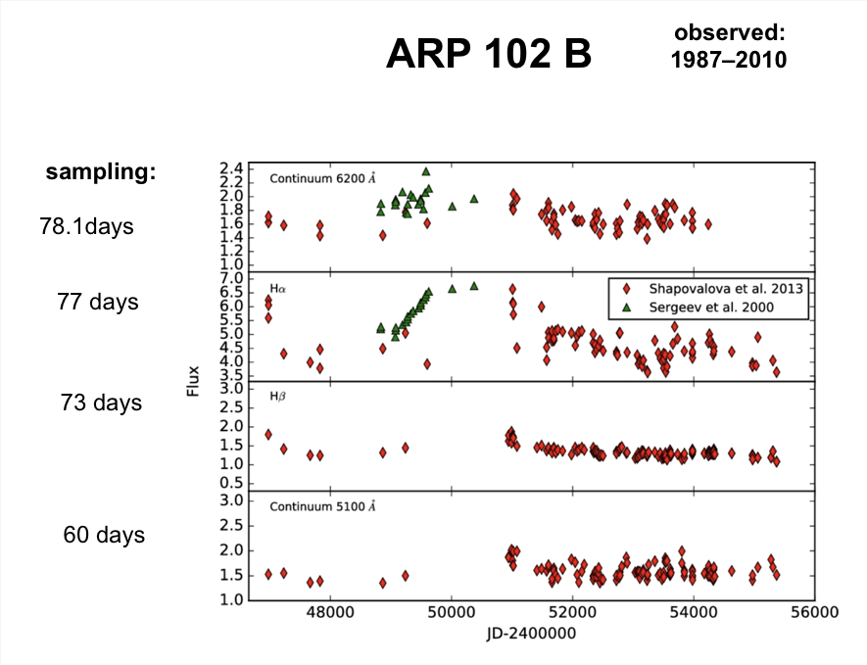
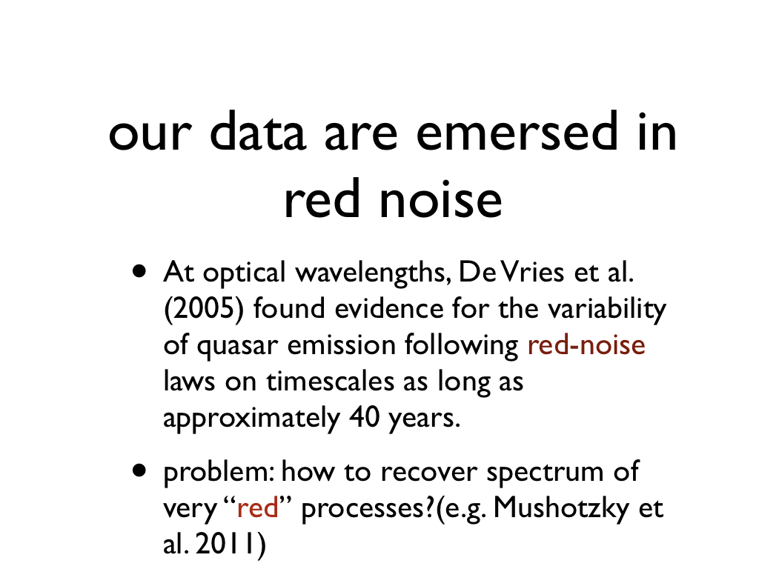
Notes:
Andjelka

Slide 18
VISUAL EXPLANATION OF CROSS-CORRELATION
Cross-correlation is a measure of similarity between two signals. It works by sliding one signal across another and finding the optimal match. This is also known as a sliding dot product or sliding inner-product and is closely related to convolution.
A cross-correlation "slides" one signal along another to determine maximal overlap. Animated gif from WSU's RoboSub project.
Notes:
Andjelka

Slide 19
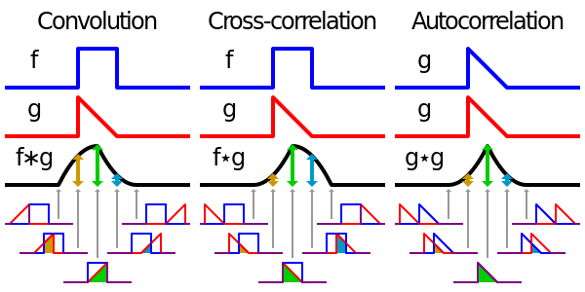
COMPARISON OF OPERATIONS ON SIGNALS
https://primo.ai/index.php?title=Convolution_vs._Cross-Correlation_(Autocorrelation)
Notes:
Andjelka

Slide 20
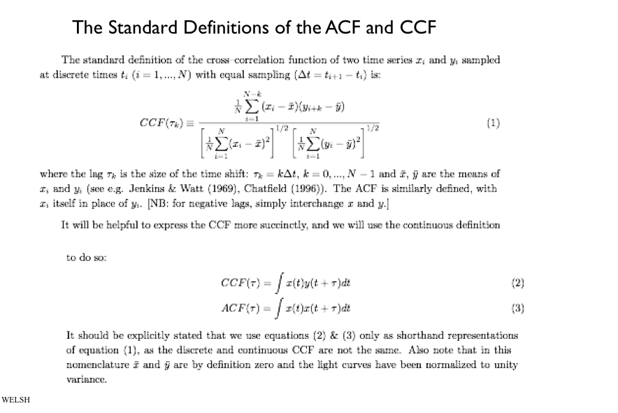
Notes:
Andjelka

Slide 21
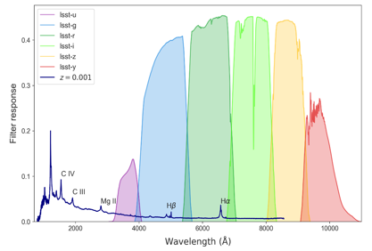
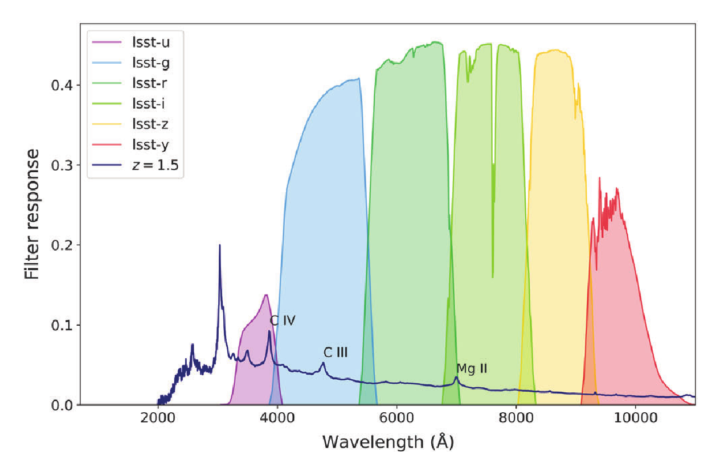
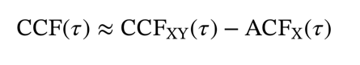
Photometric RM = PhotoRM
employs a broad band to measure AGN continuum variations and a suitable narrow band to trace the echo of an emission line in the BLR (Haas et al. 2011)
suitable for upcoming large surveys like the LSST
line emission hidden in the broadband light curve
time lag from cross (CCF) and auto-correlation functions (ACF)
(Chelouche & Daniel 2012, Edri et al. 2012)
Z=0.0
Jankov et al. 2022
Z=1.5
→ Example Notebook
Notes:
Dragana

Slide 22

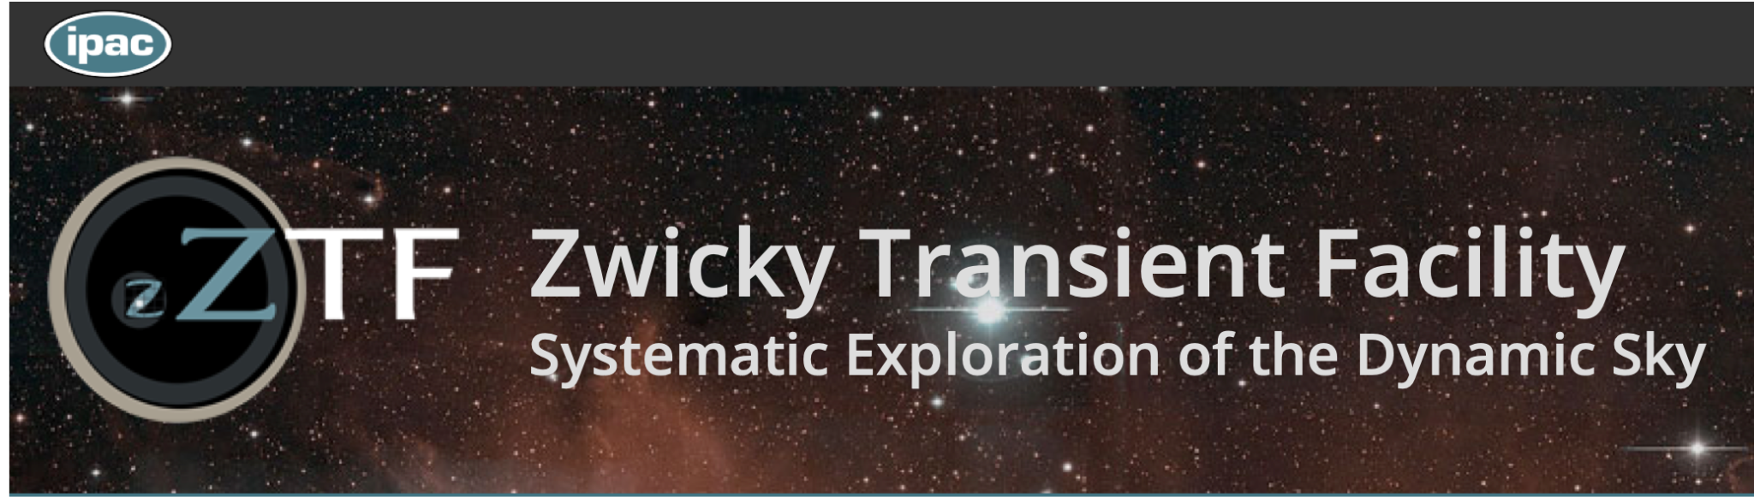
PhotoRM of AGNs
Authors: Isidora Jankov, Andjelka Kovacevic, Dragana Ilic, Paula Sánchez-Sáez and Robert Nikutta
Many thanks to Prof. Eli Waxman, Amir Bar On and former students of Prof. Tal Alexander for their kind assistance regarding the development of pyZDCF module.
Notebook contains (following Astro DataLab principles)
tools for getting photometric light curves: ANTARES API, ZTF API and simulations;
data: AGN light curves from Zwicky Transient Facility (ZTF) and AGN catalogue of Sánchez-Sáez et al. (2021);
possibility to generate artificial AGN light curves using method described in Kovačević et al. (2021b);
pyZDCF module which emulates a Fortran code for calculating CCF of astronomical time-series using the ZDCF method (Alexander 1997);
PhotoRM based on formalism by Chelouche & Daniel (2012);
https://datalab.noirlab.edu/
https://www.ztf.caltech.edu/
→ Example Notebook on AstroDatalab
https://datalab.noirlab.edu/
Notes:
The Zwicky Transient Facility (ZTF) is a public-private partnership aimed at a systematic study of the optical night sky. Using an extremely wide-field of view camera, ZTF scans the entire Northern sky every two days. The resulting large area survey will enable the astronomical community to pursue a broad range of time-domain science ranging from near-Earth asteroids to the study of distant superluminous supernovae.

Slide 23
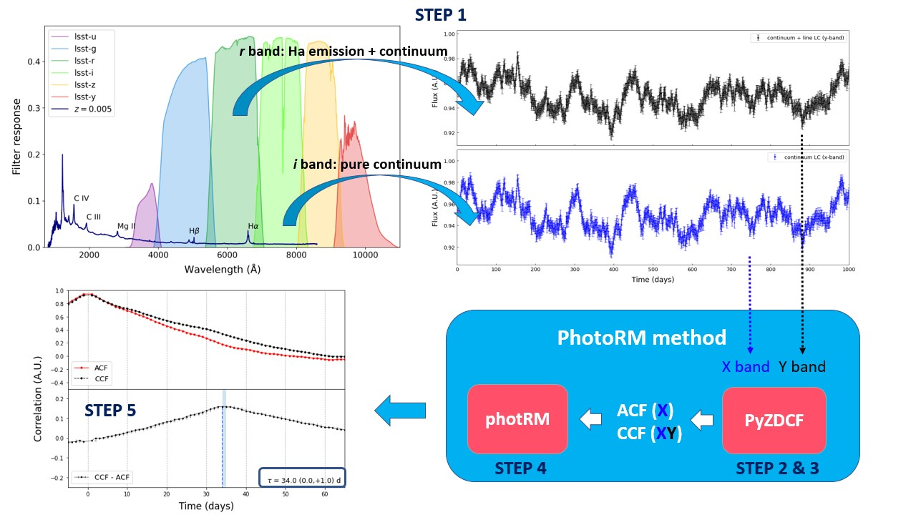
PhotoRM of AGNs in 5 steps

Slide 24
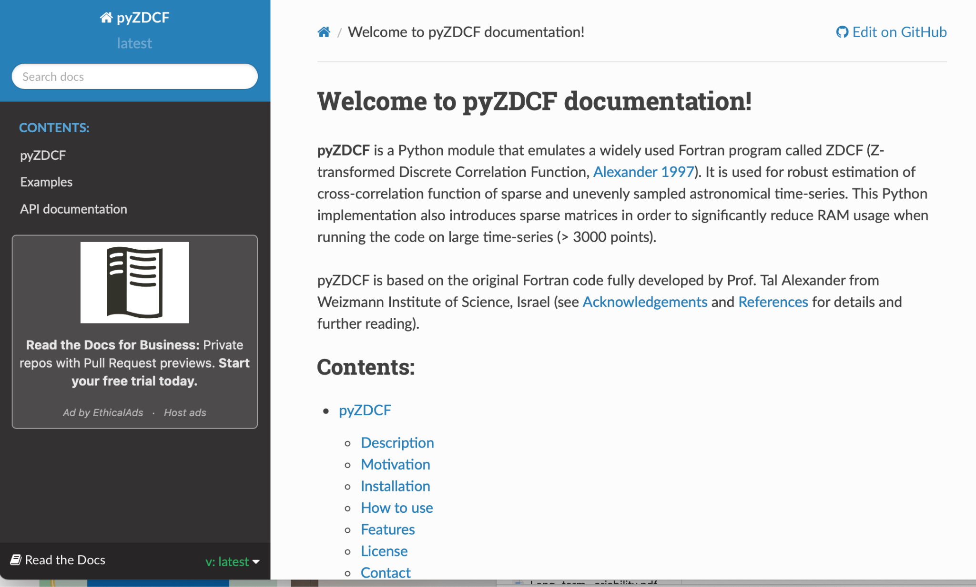
pyZDCF
The pyZDCF module is based on the original Fortran code developed by late Prof. Tal Alexander (Weizmann Institute of Science, Israel).
https://pyzdcf.readthedocs.io/en/latest/

Slide 25

Summary
LSST, will be the largest 10-year long movie of the sky! Operation starts in 2024
Opens the new parameter space for AGN research
science case: Photo Reverberation Mapping (PhotoRM) to map the inner structure of AGN
https://github.com/LSST-sersag/dle/

Slide 26
Extra Slides

Slide 27
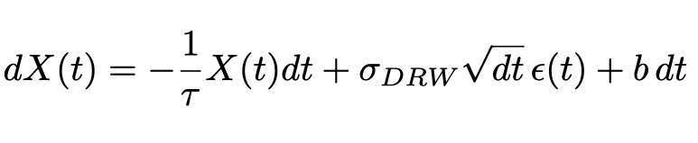
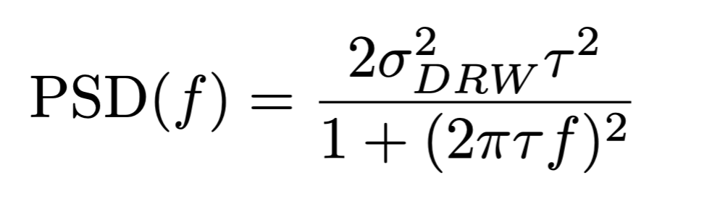
AGN Variability: what do we know?
Kelly et al. (2009) proposed that a Damped Random Walk (DRW) process can be a good descriptor for AGN light curves.
Fourier transformation

Slide 28




Photometric reverberation mapping
tested on modeled light curves (Kovačević et al. 2021) with different cadences
True lag
36.9 days
ideal (1-day)
with gaps
LSST-like
see for details Jankov et al. 2022
Notes:
CCF(dashed),ACF(solid),and their difference (lower panels) for simulated AGN light curves with different cadences (Table 1, Object ID = 13). Top: Ideal 1-day cadence;
Middle: the hypothetical variable cadence; and bottom: the “agnddf” LSST OpSim cadence. Second-order spline interpolation and the LOWESS fit (blue solid line) are used together to obtain the difference between the CCF and ACF. True value of the time-lag is 𝜏true = 36.9 days, and estimated ones are indicated on each panel in the bottom right

Slide 29

Red noise

Slide 30


AGN contain line-emitting gas
many AGN spectra have broad emission lines - Broad Line Region - BLR
how do we know there is a BLR? WE DON’T!
imaging: VLT- GRAVITY (10 μas, Sturm+ 18,20,21), future ELTs
spectroscopy very important! how can we use photometry?
yet, BLR physics and geometry not fully known
1. e.g. what is gas temperature and density? (Ilic+2012)
2. is it virialized to the supermassive black hole? (Popovic+2019)
3. do we have outflows, inflows? (e.g. Wang+2017)
4. what is the inclination? (e.g. Afanasiev+2018)
van den Berk+ 2001
Notes:
Dragana

Slide 31
4 types of reverberation mapping
Photometric RM = irradiated+response flux
Cackett+21: The schematic highlights the main components and the four types of reverberation: X-ray reverberation, optical/UV continuum reverberation broad line region reverberation, and dust reverberation ( with general radial scales from the black hole indicated by labels.

Slide 32


Slide 33



DATA MINING RESEARCH WITH LSST
From presentation by Borne, Strauss and Tyson

Slide 34


Reverberation Mapping (RM)
there is a time-delay between continuum and line flux
this delay gives the size of the broad line region (BLR)
Shapovalova+ 2008
galaxy NGC 4151 light curves
continuum
line signal lags continuum
Line
R
time-delay τ = size R_{BLR}
Time →
Lyutyi & Cherepashchuk, 1972; Blandford & McKee, 1982; Gaskell & Sparke, 1986;
Notes:
Dragana

